Slide 1



Project Target Company
IT
Business Analytics
Analytic case for Bank Company
Speaker:
Natalia Kudriavtseva
Position:
Business Analyst

Slide 2

Bank Marketing
Target Company for determine ideal customer profile
Analytic purpose - creation of ideal customer profile , who tends to have an acceptance of positive response on an advertising.
Processing of Data Frame
Formation of continuous and categorical variables for analysis
Conduct exploratory data analysis
Summary: need to understand all points of ideal customer and form description for new marketing target company, which will be focused only on right categories of clients.

Slide 3

Data Cleaning and Preparation
IT
Pre-processing of Data Frame
Data downloading
First step in processing of Data Frame
Library connection for analysis
Pandas , Nampy, Matplotlib, Seaborn, Datetime
Downloading the Data Frame
- 15 000 rows
- CSV
- collection of 2015 -2021
Correction
Type of attribute
Header
Checking of duplicate
Duplicate
Abnormality
Recovering of missing data or deletion

Slide 4
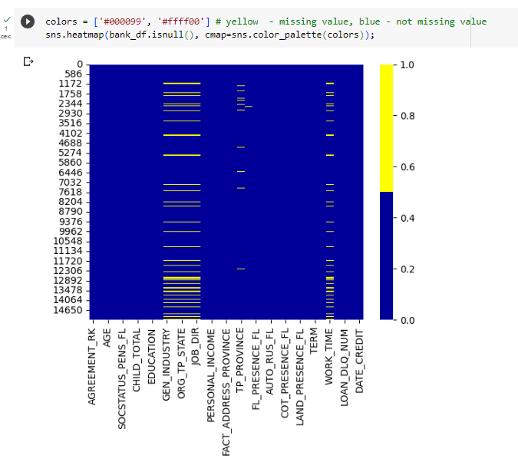
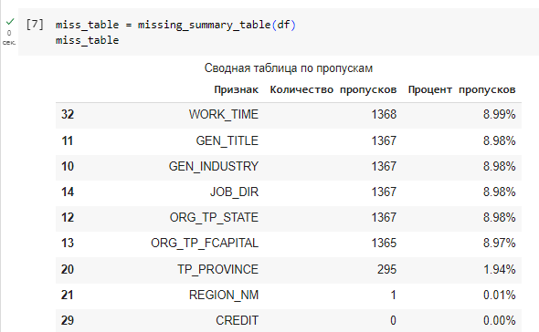
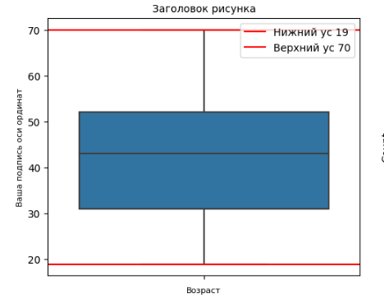
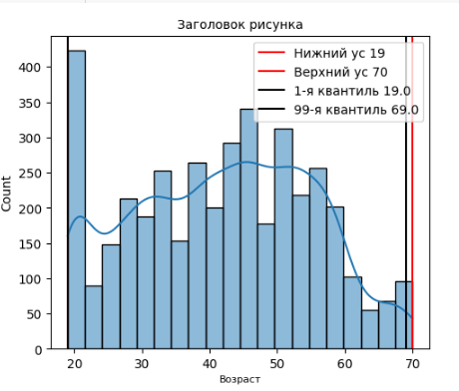
Method
Pre-processing of Data Frame
Data Frame
Make request for info Data Frame bank_df.info()
Put correction in headers by method bank_df.columns.str.lower()
Look at missing attributes by different methods(%, sum, miss_table, sns.heatmap) : 1500 attributes were lost
- ‘work_time’ 9% : repair by mean
- ‘gen_title’, ‘gen_industry’, ‘org_tp_state’, ‘org_tp_fcapital’ :
9% str – remove
- ‘region_nm’ - 0.01% – remove
- ‘tp_province’ – 2% repair by replacement from ‘region’
Divide into continuous and categorical variables
Create boxes with max/min and density diagrams for all variables and find abnormalities
- ‘fact_living_term’ : have “ – “ figures ,apply method - abs()
- ‘child_total’ : 10 children, it could be

Slide 5
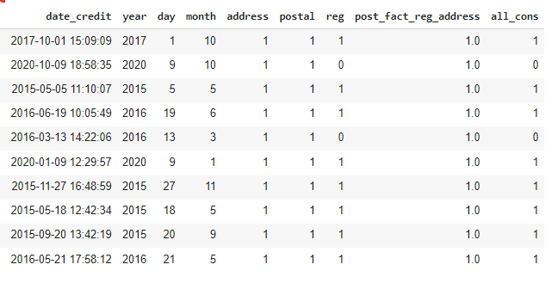
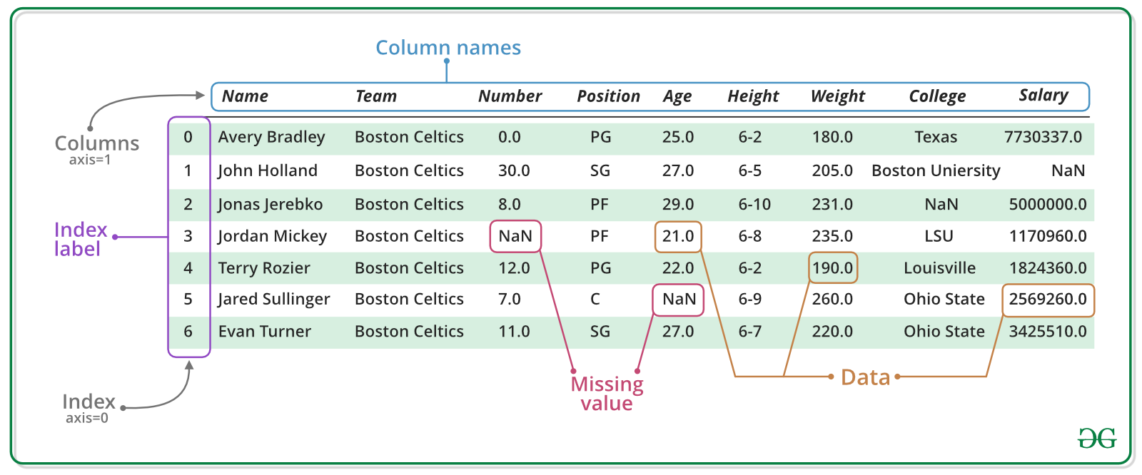

Add Variables for
Analysis
Categorical variables
1 – coincidental , 0 – not coincidental
Divide column ‘date_credit’ into three marks ‘year’ , ‘day’ , ‘month’
By means of cycle we add in Data Frame
‘address ‘ – address of registration and address of the actual place of residence
‘postal ’ - address of the actual place of residence and postal address
‘reg’ - address of registration and postal address
‘postal_address_province‘ - postal address, address of the actual place of
residence and address of registration
‘all_cons‘ - address of registration, address of the actual place of residence
, postal address and , address of credit point of sale

Slide 6
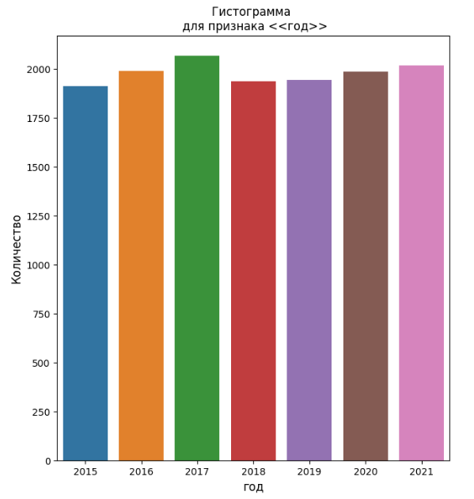
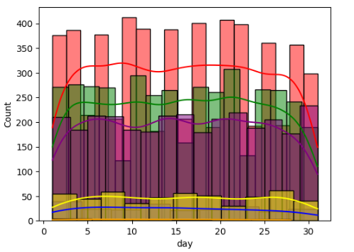
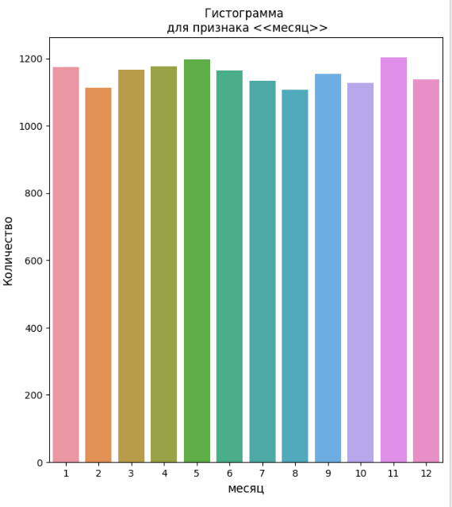
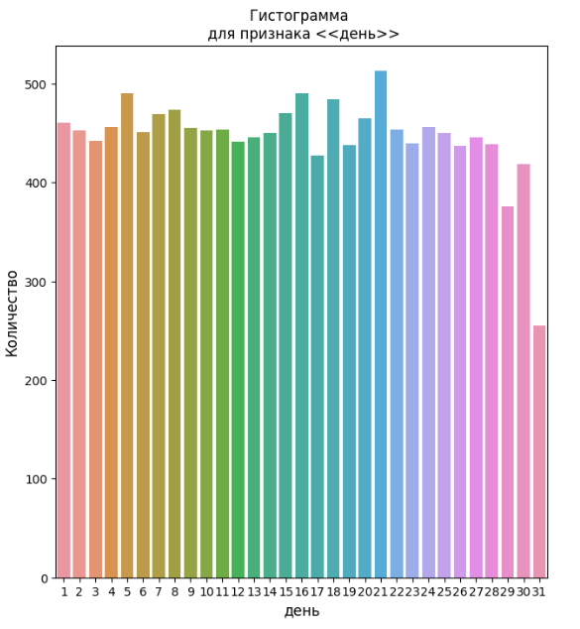
Conducting
Exploratory Analysis
Analysis from the point of view by categorical variables
Look at efficiency of target company by -
plotly import graph_objects as go
Look at dependency in all categorical variables by client’s education - plt.subplots
special secondary
secondary
incomplete secondary education
higher education
incomplete higher education
2 and more higher educations
academic degree
Look at dependency in categorical variables year, month, day by number of client who got a credit before -
plt.subplots with enumerate( )

Slide 7
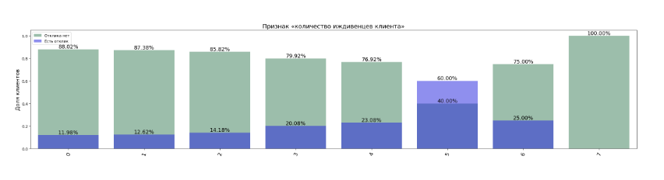
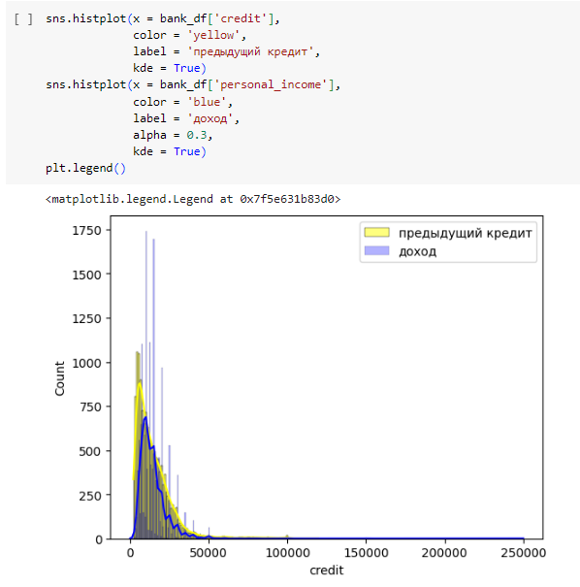
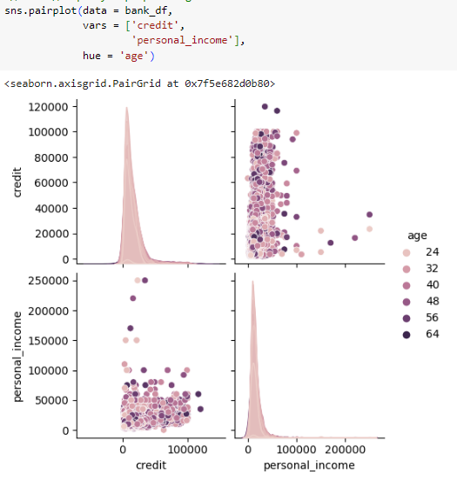
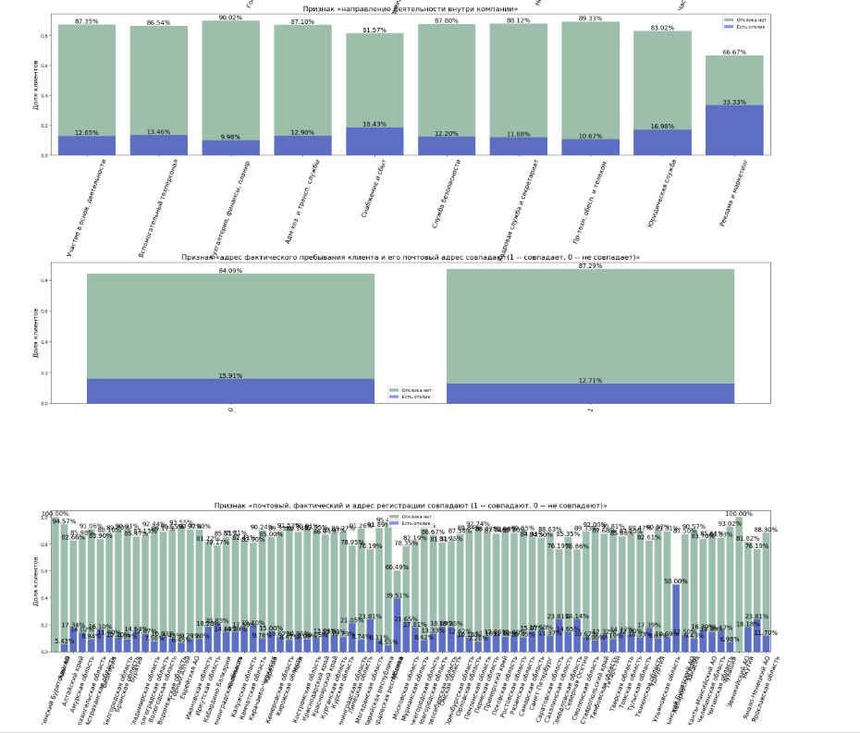
Conducting
Exploratory Analysis
Analysis from the point of view by continuous and categorical variables
Look at the all categorical variables in % by 'target‘
For this we have to create the disc_var1 and give all description in Rus. language - dict_to_rus1
apply fig, axes = plt.subplots( )
fig.tight_layout( )
Show % in correlation by all columns
Look at the dependence of continuous variables , as the ‘credit‘ by 'personal_income‘ with sns.histplot
Consider the ‘credit’ and 'personal_income'
by ‘age’ and 'target‘ with sns.pairplot

Slide 8
Ideal Customer Profile
For Future Target Marketing Company
IT
Male/Female sex in age 30-38 years
Have children or dependents
Married / living together / in divorce
Have secondary or higher education
To a greater extent to have an own car than not
Work in marketing, real property area, business, entrepreneur. The area connects with internet
and very often to put attention on advertising
Have experience to getting a credit before and clearly understand how they can pay in according to they income
without missing payment
Work position as middle manager, private entrepreneur. Also it was reaction from military servicemen , obviously it depends on launched company before.
Place of getting a credit is not depend on target and decision of acceptance . Target was good in Ulianovskiy region 50% and Mordovskay republic 39.5%
Seasonal interest depends on days off, holidays and months. Be observed decrease in February , August , October, December.
Response to the marketing target during 7 years show the stability result as 13%

Slide 9

Название здесь
Kudriavtseva Natalia
Keep in touch with me :
Telephone +79818946536
kudryavtseva-natalia.spb@yandex.ru
Thank you for your time !

